Slide 1
Machine Learning
Classification
Pranav Agrawal

Slide 2
Introduction
Pranav Agrawal holds a B.E. Degree in Mechanical Engineering.
6+ years of experience in the field of Data Science and Machine Learning.
Created and Deployed several Machine Learning and Deep Learning Models.
Author of “Four Wheel Active Steering System” and conducted several Data Science webinars.

Slide 3
Agenda
Importance of Machine Learning
Learning: Types
Supervised Learning: Types
Classification in Machine Learning
Classification Tasks: Types
Classification Model: Evaluation Metrics

Slide 4
Importance of Machine Learning
Machine learning is a branch of artificial intelligence (AI) and computer science which focuses on the use of data and algorithms to imitate the way that humans learn, gradually improving its accuracy.
Using statistical methods, algorithms are trained to make classifications or predictions and to uncover key insights in data mining projects.
These insights subsequently drive decision-making within applications and businesses, ideally impacting key growth metrics.

Slide 5
Learning: Types
Semi-Supervised learning
Unsupervised learning
Reinforcement learning
Supervised (inductive) learning
Given:
training data + desired output (labels)
Example:
Spam detection
Given:
training data + a few desired outputs
Example:
Text Classification
Given:
training data (without desired outputs)
Example:
Identifying Accident Prone Areas.
Rewards from a sequence of actions.
Example:
Game playing

Slide 6
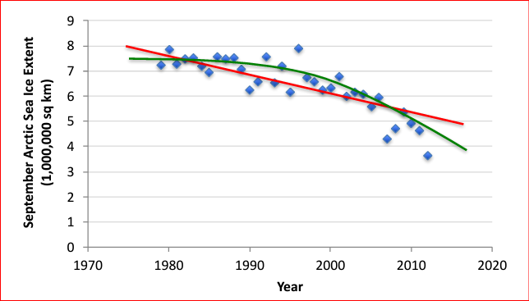
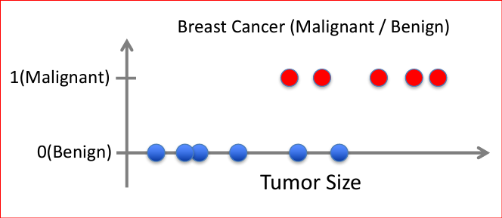
Supervised Learning: Types
Differentiated based on the prediction task or the target variable.
Regression
Classification
Given: (x1, y1), (x2, y2), ..., (xn, yn)
Learn a function f(x) to predict y given x
– y is real-valued == regression
Given: (x1, y1), (x2, y2), ..., (xn, yn)
Learn a function f(x) to predict y given x
– y is categorical == classification
References:
Data from G. Witt. Journal of Statistics Education, Volume 21, Number 1 (2013)
Based on example by Andrew Ng

Slide 7
Classification in Machine Learning
Classification is a supervised machine learning method where the model tries to predict the correct label of a given input data. In classification, the model is fully trained using the training data, and then it is evaluated on test data before being used to perform prediction on new unseen data.
Eager Learners
Lazy Learners
Constructs a classification model based on the training data before getting data for prediction.
Less time to make predictions.
Examples:
Logistic Regression.
Support Vector Machine.
Decision Trees.
Artificial Neural Networks.
Simply stores the training data and wait until a test data appears.
Very slow to make predictions.
Also called as Instance based Learners.
Examples:
K-Nearest Neighbour.
Case-based reasoning.

Slide 8

Classification Tasks: Types
Pick One |  | Pick One |  | Pick All Applicable
Label 1 | ✓ | Label 1 |  | Label 1 | ✓
Label 2 |  | Label 2 |  | Label 2
 |  | Label 3 | ✓ | Label 3 | ✓
 |  | Label 4 |  | Label 4
 |  | … |  | …
 |  | … |  | …
 |  | Label L |  | Label L | ✓
Binary |  | Multi-Class |  | Multi-Label

Slide 9
Classification Tasks: Types
Binary Classification
Multi-label Classification
Multi-Class Classification
Imbalanced Classification
Goal: Classify the input data into Two mutually exclusive categories
Predict:
Bus or Train.
Algorithms:
Logistic Regression, SVM, Decision Trees.
Goal: Classify data into 0 or more classes for each input example.
Predict:
Dog, car and person.
Algorithms:
Multi-label Decision Trees, Multi-label Gradient Boosting, Multi-label Random Forests
Goal: Classify data into At least Two mutually exclusive categories
Predict:
Bus, Car or Train.
Algorithms:
Logistic Regression, SVM, Decision Trees, Random Forest, Naïve Bayes
Goal: The number of examples is unevenly distributed in each class
Predict:
Fraudulent transaction detections, Rare disease diagnosis.
Algorithms:
Cluster-based Oversampling, Random undersampling, SMOTE Oversampling.

Slide 10
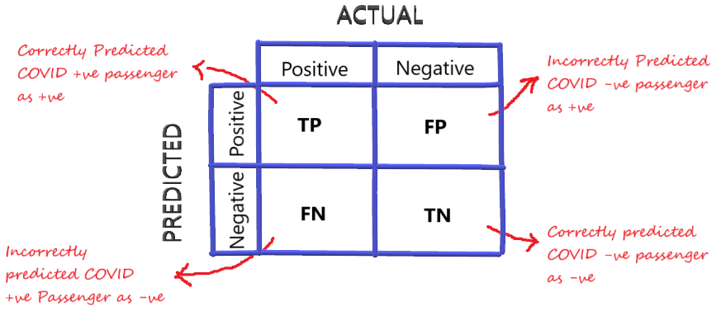
Classification Model: Evaluation Metrics
Confusion/Error Matrix : An nXn matrix that nicely summarizes the number of correct predictions for the model. Helps to compute different performance metrics.
References:
https://www.analyticsvidhya.com/blog/2020/10/how-to-choose-evaluation-metrics-for-classification-model/

Slide 11
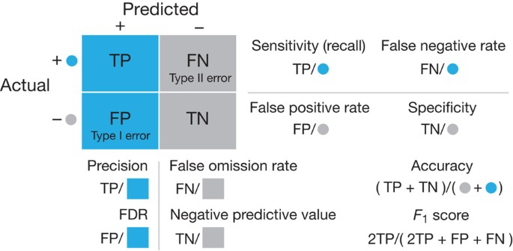
Classification Model: Evaluation Metrics
Term | Meaning
Accuracy | Out of the predictions made by the model, what percentage is correct?
Precision | Out of all the YES predictions, how many of them were correct?
Recall/ Sensitivity | How good was the model at predicting Real YES events?
Specificity | How good was the model at predicting Real NO events?
F1 Score* | Used for the Imbalanced dataset. (Precision Recall Tradeoff)
References:
https://www.nature.com/articles/nmeth.3945

Slide 12
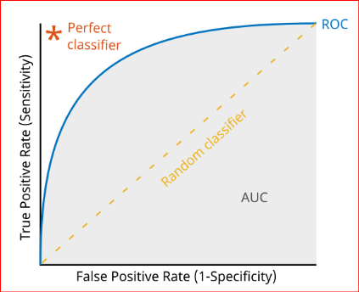
Classification Model: Evaluation Metrics
AUC-ROC Curve : Generates probability values instead of binary 0/1 values. Used for roughly balanced dataset.
References:
https://www.mathworks.com/help/deeplearning/ug/compare-deep-learning-models-using-ROC-curves.html

Slide 13
Questions?

Slide 14
Thank you
Pranav Agrawal
79995-16598
pranav.ag007@gmail.com

